Slide 1

Reporting and Preparing Financial Statements
3
Chapter
UAA – ACCT 201 Principles of Financial Accounting Dr. Fred Barbee

Slide 2
IS FUN!
ACCOUNTING
ACCT 201 ACCT 201 ACCT 201

Slide 3
What Have We Learned?
I have some bad news . . .
Notes:
Good News Vs. Bad News
I have some good news and some bad news . . .
The bad news is that there is lots more to come.

Slide 4
What Have We Learned?
I have some good news . . .
Notes:
Good News Vs. Bad News
I have some good news and some bad news . . .
The good news is that if you keep at it, you will be able to learn accounting.

Slide 5

We Have Learned . . .
The basic accounting equation - and the definition of each of its components
  Assets =
  Liabilities +
  Owners’ Equity

Slide 6
We Have Learned . . .
Double-entry accounting
  Assets = Liabilities + Owners’ Equity
  Debits=Credits

Slide 7
We Have Learned . . .
The debit/credit rules and how each impacts accounting.
Debit = “Left” side of an account - Nothing more, nothing less.
Acronym:
ncrease
IDEA
ebits
xpenses
ssets
IDEA

Slide 8
We Have Learned . . .
The debit/credit rules and how each impacts accounting.
evenue
Credit = “Right” side of an account - Nothing more, nothing less.
Acronym:
quity
RELIC
iabilities
ncrease
redits
RELIC

Slide 9



We Have Learned . . .
Income
Statement
Net Income
Stmt of Retained Earnings
Retained Earnings
ACCT 201 ACCT 201 ACCT 201
About the basic financial statements and how they interrelate.
Balance
Sheet

Slide 10



We Have Learned . . .
The first five steps in the accounting cycle.
Prepare Trial Balance
ACCT 201 ACCT 201 ACCT 201
Post Transactions
Record Transactions
Analyze Transactions
Examine Source Documents

Slide 11
Notes:
Wow, we should be ready to go out and get a job as an accountant. Right? Wrong! There are a few more things we must learn.

Slide 12
Preparing Financial Statements
Financial Statements
No!
Prepare Trial Balance
ACCT 201 ACCT 201 ACCT 201
Post Transactions
Record Transactions
Analyze Transactions
Examine Source Documents

Slide 13

Problems in Accounting Measurements
The identification of the accounting period.
The proper point in time to recognize revenue.
The appropriate moment to record an expense.

Slide 14
Problem One
ACCT 201 ACCT 201 ACCT 201
Identification of the Accounting Period
Notes:
Introduction and Review
We have covered a lot of ground in the last few class sessions. Your head is probably swimming with all of the new information we have been trying to stuff in.

Slide 15

Time Period Principle
For reporting purposes, an organization’s life can be divided into separate accounting periods
  months,
  quarters,
  years, etc.

Slide 16
Time Period Principle
Discrete (separate) accounting periods.
BEGINNING
ENDING
96
97
98
99
00
01
02
03
04
05
Life of the Firm

Slide 17
The Accounting Period
Exh.
3.1
Annual
1
2
Semiannual
1
2
3
4
Quarter
1
2
3
4
5
6
7
8
9
10
11
12
Month
Notes:
5
5

Slide 18
Problem Two
ACCT 201 ACCT 201 ACCT 201
The proper point in time to recognize revenues.
Notes:
Introduction and Review
We have covered a lot of ground in the last few class sessions. Your head is probably swimming with all of the new information we have been trying to stuff in.

Slide 19
Revenue Recognition . . .
Revenues are recorded when two main criteria have been met:
  The earnings process is substantially complete (a sale has taken place or service has been rendered); and
  An exchange has taken place.
Notes:
Recognition of Revenue
OK, this is the revenue recognition principle. This isn’t overly complex; however, we can simplify it even more.

Slide 20
Revenue Recognition . . .
Revenue is generally recognized
  At the time services are performed; or
  When goods are sold and delivered to a customer.
Notes:
Recognition of Revenue
OK, this is the revenue recognition principle. This isn’t overly complex; however, we can simplify it even more.

Slide 21
Problem Three
ACCT 201 ACCT 201 ACCT 201
The proper point in time to recognize expenses.
Notes:
Introduction and Review
We have covered a lot of ground in the last few class sessions. Your head is probably swimming with all of the new information we have been trying to stuff in.

Slide 22
The Matching Principle
The matching principle requires that all expenses incurred to generate the revenues recognized in an accounting period be matched with those revenues.

Slide 23

The Matching Principle
Another view . . .
  Let the expense follow the revenue.
    First the revenue . . .
    Then the expense.
Sometimes referred to as “The Expense Recognition Principle.”
Notes:
Cost of Goods Sold
The cost of merchandise sold, for example should be matched to the revenue derived from the sale of that merchandise during the period.
The problem arises when there is no direct cause-and-effect between the expense and revenues.

Slide 24







Matching
Principle
Expense
Asset
Useful Life
$100,000
$100,000/5=$20,000

Slide 25
Accounting Bases
Accrual Basis Accounting

Slide 26
Revenue Recognition
Accrual Basis Accounting
ACCT 201 ACCT 201 ACCT 201
Matching Principle
Notes:
Depreciation
To overcome this problem, accountants employ a systematic approach and gradually expense the cost of such assets over an estimated service life.
This is known as depreciation and will be discussed in some detail later.

Slide 27

Yikes!! What is Accrual Basis Accounting?
ACCT 201 ACCT 201 ACCT 201

Slide 28
Accrual Basis Accounting
Revenues are recognized (recorded) when earned, without regard to when cash is received;
Expenses are recorded as incurred without regard to when they are paid.

Slide 29
The time period principle
  Gives rise to the need for
The Revenue Recognition Principle and the Matching Principle
  Resulting in . . .
The accrual basis of accounting
ACCT 201 ACCT 201 ACCT 201

Slide 30

Whoa! Let’s back up a bit here -- this really does make sense?
ACCT 201 ACCT 201 ACCT 201

Slide 31

96
97
98
99
00
01
02
03
04
05
Periodicity Assumption
?
?
?
?
?
?
How do we recognize revenues?
The Revenue Recognition Principle
How do we recognize expenses?
The Matching Principle
Accrual Basis Accounting
Notes:
Periodicity
All businesses issue their financial statements on a periodic basis so that users can make sound economic decisions.
Users of financial statements need to be able to judge a company’s financial position in a timely manner.

Slide 32


Accrual Accounting . . .
BOP
EOP
Recognized Revenues
Matched Expenses
Recognized Revenues
Matched Expenses
Accrual Net Income
Notes:
1. Revenue Recognition and
2. The Matching Principle
are the cornerstone of the accrual basis of accounting.

Slide 33


Bertha, are there any other bases for accounting?
Yikes! I don’t know Claude. We probably better ask the professor!

Slide 34
Absolutely. You don’t think we would make it that easy, do you?
ACCT 201 ACCT 201 ACCT 201

Slide 35
Accounting Bases
Cash Basis Accounting

Slide 36
Cash Basis Accounting
With the cash basis . . .
  Revenues are recognized in the period cash is received; and
  Expenses are recognized in the period when cash is paid out.
Notes:
Cash Basis Accounting
The cash basis of accounting is criticized as not being in accord with economic reality. Stated simply, the receipt and disbursement of cash do not adequately measure financial activity during a given time period.

Slide 37
Cash Basis Accounting . . .
BOP
EOP
Revenue (Cash)
Expenses (Cash)
Revenue (Cash)
Expenses (Cash)
Cash Basis Net Income

Slide 38
Ahhh, but there is yet another one! Fun! Fun!
ACCT 201 ACCT 201 ACCT 201

Slide 39
Accounting Bases
Modified Cash Basis Accounting

Slide 40
Modified Cash Basis Accounting
With the Modified Cash Basis . . .
  Current period revenues and expenses are treated exactly as in the cash basis;
  Expenses covering more than one accounting period are allocated over the useful life of the asset.
Notes:
Cash Basis Accounting
The cash basis of accounting is criticized as not being in accord with economic reality. Stated simply, the receipt and disbursement of cash do not adequately measure financial activity during a given time period.

Slide 41
Adjusting the
Accounts
ACCT 201 ACCT 201 ACCT 201
Notes:
Introduction and Review
We have covered a lot of ground in the last few class sessions. Your head is probably swimming with all of the new information we have been trying to stuff in.

Slide 42
Adjusting Accounts
Exh.
3.4
An adjusting entry is recorded to bring an asset or liability account balance to its proper amount.
Notes:
12
12

Slide 43
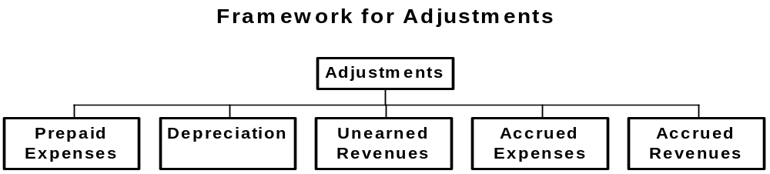
Framework for Adjustments
Exh.
3.4
Transactions where cash is paid or
received before a related expense
or revenue is recognized.
Transactions where cash is paid or
received after a related expense
or revenue is recognized.
Notes:
12
12

Slide 44
Framework for Adjustments
Exh.
3.4
Transaction where cash is paid before a related expense is recognized.
Notes:
12
12

Slide 45
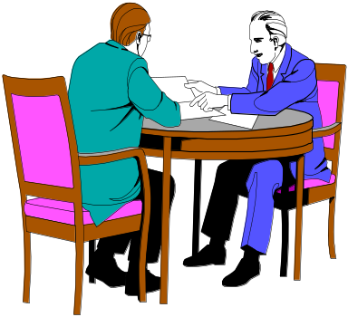
Adjusting Prepaid Expenses
Resources paid for prior to receiving the actual benefits.
Here is the check
for my first
6 months’ rent.
Asset
Expense
Unadjusted
Balance
Credit
Adjustment
Debit
Adjustment
Notes:
14
14

Slide 46
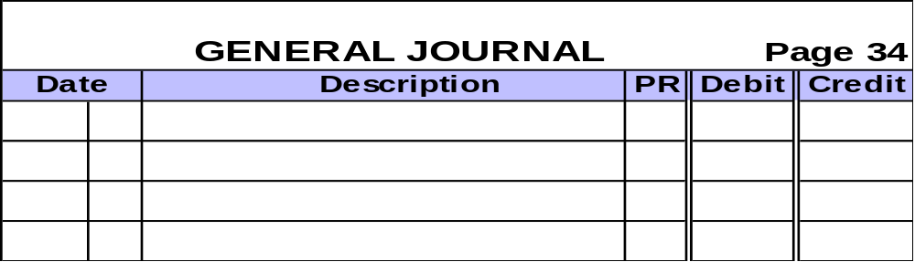
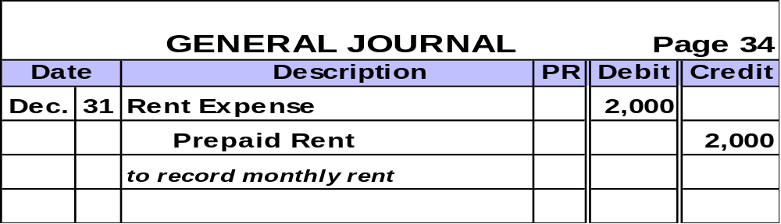
Adjusting Prepaid Expenses
  On December 1, 2001, Scott Company paid $12,000 to cover rent for December 2001 through May 2002.
  Let’s look at the adjusting journal entry needed on December 31, 2001.
Notes:
16
16

Slide 47
Adjusting Prepaid Expenses
  After posting, the accounts involved look like this:
Prepaid Rent
Rent Expense
12/1 $12,000
12/31 $2,000
12/31 $2,000
Notes:
18
18

Slide 48
Framework for Adjustments
Exh.
3.4
Transaction where cash is paid before a related expense is recognized.
Notes:
12
12

Slide 49
Adjusting for Depreciation
  Depreciation is the process of computing expense from allocating the cost of plant and equipment over its expected useful lives.
Straight-Line Depreciation | = | Asset Cost – Salvage Value
 |  | Useful Life
Notes:
19
19

Slide 50
Matching
Principle
Expense
Asset
Useful Life
$100,000
$100,000/5=$20,000

Slide 51
Adjusting for Depreciation
On January 1, 2002, Monroe, Inc. purchased oil pumping equipment for $62,000 cash.
The equipment has an estimated useful life of 5 years.
Monroe expects to sell the equipment at the end of its life for $2,000 cash.
Notes:
20
20

Slide 52
Adjusting for Depreciation
Let’s compute depreciation expense for the year ended December 31, 2002.
2002 Depreciation Expense | = | $62,000 - $2,000
 |  | 5
 | = | $12,000
Notes:
20
20

Slide 53
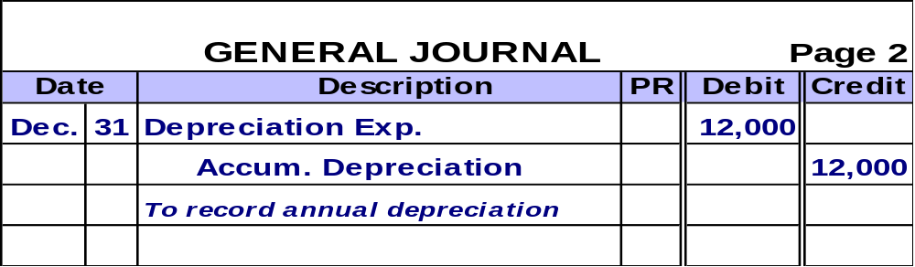
Adjusting for Depreciation
  Prepare the journal entry.
Accumulated depreciation is
a contra asset account.
Notes:
20
20

Slide 54

Adjusting for Depreciation
  After posting, the accounts involved look like this:
Equipment
Depreciation Expense
1/1 $62,000
12/31 $12,000
Accumulated Depreciation
12/31 $12,000
Notes:
23
23

Slide 55
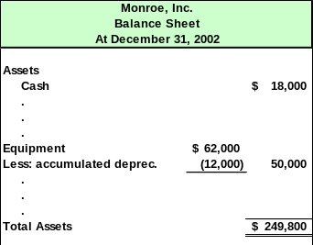
Adjusting for Depreciation
The equipment account is shown on the balance sheet like this.
Notes:
24
24

Slide 56
Framework for Adjustments
Exh.
3.4
Transaction where cash is received before a related revenue is recognized.
Notes:
12
12

Slide 57

Adjusting Unearned Revenue
Cash received in advance of providing products or services.
Buy your season tickets for
all home basketball games NOW!
“GO SEAWOLVES”
Liability
Revenue
Debit
Adjustment
Unadjusted
Balance
Credit
Adjustment
Notes:
25
25

Slide 58
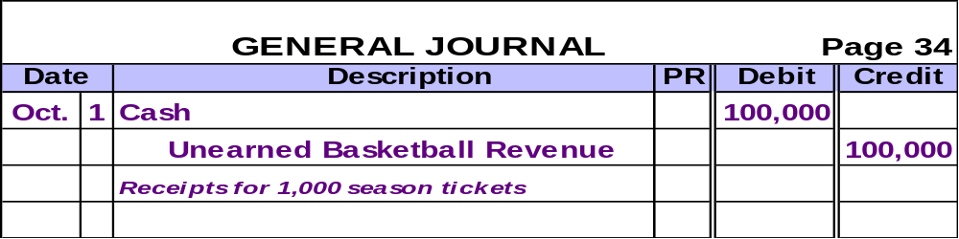

Adjusting Unearned Revenue
On October 1, 2002, UAA sold 1,000 season tickets to its 20 home basketball games for $100 each. UAA makes the following entry:
Notes:
27
27

Slide 59
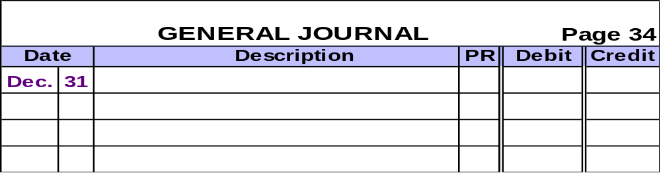
Adjusting Unearned Revenue
On December 31, UAA has played 10 of its regular home games, winning 8 and losing 2.
Prepare the appropriate Adjusting Entry on December 31
Notes:
28
28

Slide 60
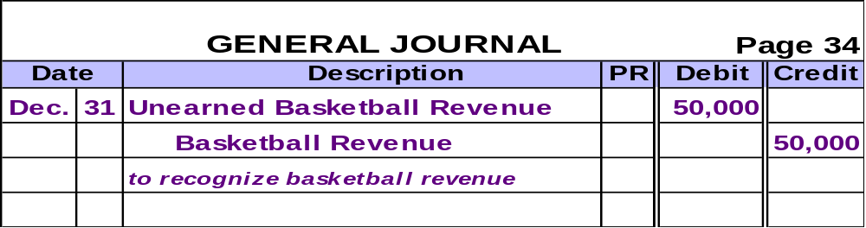
Adjusting Unearned Revenue
On December 31, UAA has played 10 of its regular home games, winning 8 and losing 2.
Notes:
28
28

Slide 61
Adjusting Unearned Revenue
  After posting, the accounts involved look like this
Unearned Basketball
Revenue
Basketball Revenue
12/31 $50,000
10/1 $100,000
12/31 $50,000
Notes:
30
30

Slide 62
Framework for Adjustments
Exh.
3.4
Transaction where cash is paid after a related expense is recognized.
Notes:
12
12

Slide 63


Adjusting for Accrued Expenses
Costs incurred in a period that are
both unpaid and unrecorded.
We’re about one-half
done with this job and
want to be paid!
Expense
Liability
Debit
Adjustment
Credit
Adjustment
Notes:
31
31

Slide 64
Adjusting for Accrued Expenses
Denton, Inc. pays its employees every Friday. Year-end, 12/31/02, falls on a Wednesday. As of 12/31/02, the employees have earned salaries of $47,250 for Monday through Wednesday of the week ended 1/02/03.
Last pay
date
12/26/02
Next pay
date
1/2/03
12/1/02
12/31/02
Year end
Record adjusting
journal entry.
Notes:
33
33

Slide 65
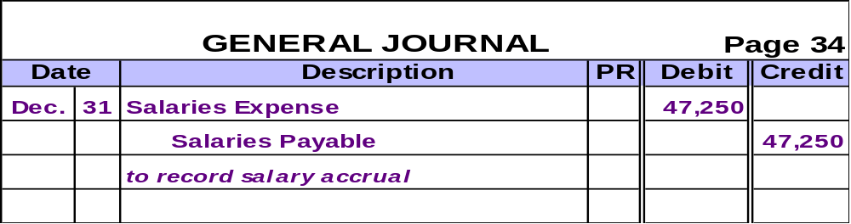
Adjusting for Accrued Expenses
Denton, Inc. pays its employees every Friday. Year-end, 12/31/02, falls on a Wednesday. As of 12/31/02, the employees have earned salaries of $47,250 for Monday through Wednesday of the week ended 1/02/03.
Notes:
33
33

Slide 66
Adjusting for Accrued Expenses
  After posting, the accounts involved will look like this . . .
Salaries Expense
Salaries Payable
12/31 $47,250
12/31 $47,250
Notes:
35
35

Slide 67
Framework for Adjustments
Exh.
3.4
Transaction where cash is received after a related revenue is recognized.
Notes:
12
12

Slide 68
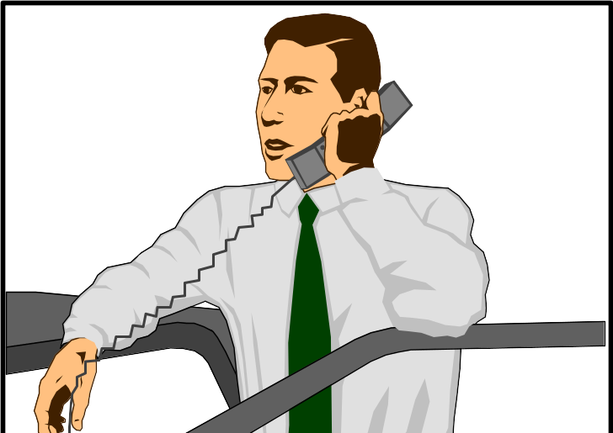
Adjusting for Accrued Revenues
Revenues earned in a period that
are both unrecorded and not yet received.
Yes, you can pay me
for your tax return
when I finish the work.
Asset
Revenue
Debit
Adjustment
Credit
Adjustment
Notes:
36
36

Slide 69
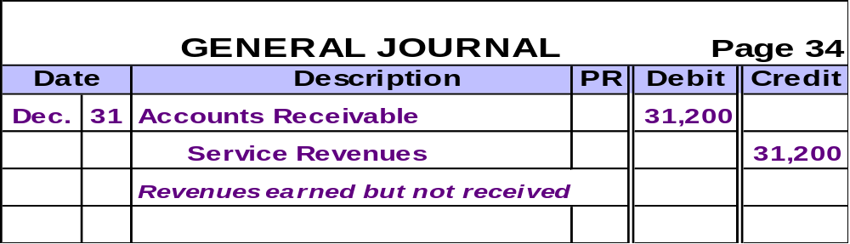
Adjusting for Accrued Revenues
Smith & Jones, CPAs, had $31,200 of work completed but not yet billed to clients. Let’s make the adjusting entry necessary on December 31, 2002, the end of the company’s fiscal year.
Notes:
38

Slide 70
Adjusting for Accrued Revenues
  After posting, the accounts involved will look like this . . .
Accounts Receivable
Service Revenue
12/31 $31,200
12/31 $31,200
Notes:
35
35

Slide 71
Adjustments And
Financial
Statements
ACCT 201 ACCT 201 ACCT 201
Notes:
Introduction and Review
We have covered a lot of ground in the last few class sessions. Your head is probably swimming with all of the new information we have been trying to stuff in.

Slide 72
Exhibit 3.18 Summary of Adjustments and Financial Statement Links
Exh.
3.18
Category | Before Adjusting |  | Adjusting Entry
 | B/S | I/S
Prepaid Expense | Asset | Expense | Dr. Expense Cr. Asset
Unearned Revenue | Liability | Revenue | Dr. Liability Cr. Revenue
Accrued Expenses | Liability | Expense | Dr. Expense Cr. Liability
Accrued Revenues | Asset | Revenue | Dr. Asset Cr. Revenue
Overstated
Understated
Notes:
41

Slide 73
FastForward
Trial Balance
December 31, 2001
Exh.
3.19
First, the initial unadjusted amounts are added to the worksheet.
Notes:
43

Slide 74
FastForward
Trial Balance
December 31, 2001
Exh.
3.19
Next, FastForward’s adjustments are added.
Notes:
44

Slide 75
Finally, the totals are determined.
FastForward
Trial Balance
December 31, 2001
Exh.
3.19
Notes:
45

Slide 76
Preparing
Financial
Statements
ACCT 201 ACCT 201 ACCT 201
Notes:
Introduction and Review
We have covered a lot of ground in the last few class sessions. Your head is probably swimming with all of the new information we have been trying to stuff in.

Slide 77
Preparing Financial Statements
Let’s use FastForward’s adjusted trial balance to prepare the company’s financial statements.

Slide 78
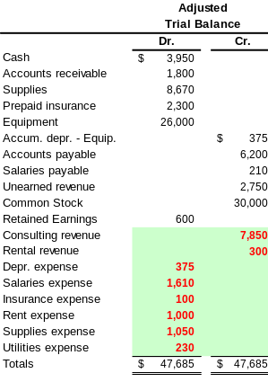
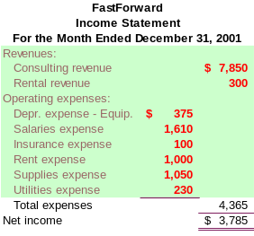
Exh.
3.20
Step One:
Prepare the Income
Statement.

Slide 79
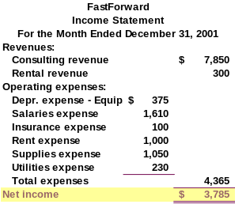
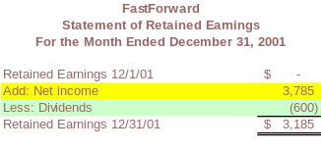
Exh.
3.20
Step Two:
Prepare the Statement of Retained Earnings.
Note: The Net Income from the Income Statement carries to the Statement of Retained Earnings.

Slide 80
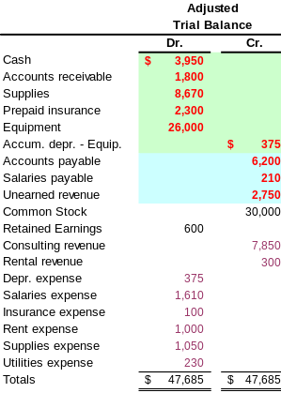
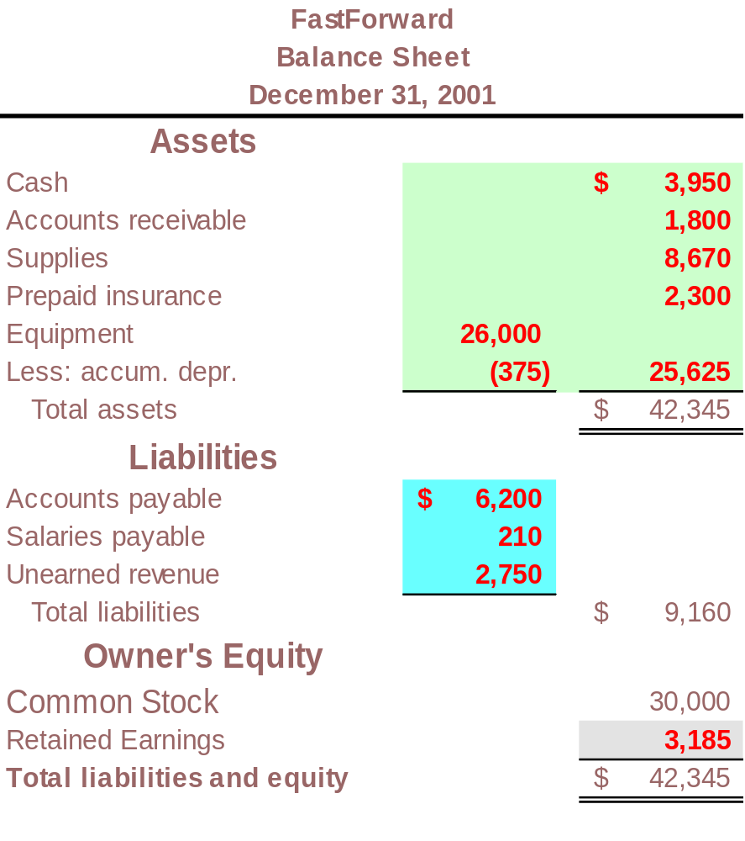
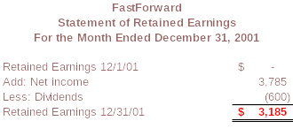
Exh.
3.20
Step Three:
Prepare the Balance
Sheet.

